Slide 1
cold sore
A is a painful recurrent herpes simplex virus (HSV1) infection that occur around the lipsarea and less common inside nose.
HSV2: infect gentalia
Infection is spread by viral Fluid from herpes vesicles contains live virus, shedding into saliva and results from direct mucous membrane (e.g. kissing) contact (at sites of abraded skin) between an infected and an uninfected individual .

Slide 2
Age
cold sores are most commonly seen in adolescents. The infection is usually contracted in childhood Following the primary attack, the virus is not completely eradicated and virus particles lie dormant in nerve roots until they are reactivated at a later stage.
Precipitating factors
Sunlight, wind, fever (during infections such as colds and ﬂu) and menstruation, local trauma to the skin. Physical and emotional stress.

Slide 3
Appearance and Symptoms
The symptoms of discomfort, tingling or irritation (prodromal phase) for 6-24hr before the appearance of the coldsore.
The cold sore starts with the development of minute blisters on top of inﬂamed, red, raised skin.
The blisters may be ﬁlled with white matter. They quickly break down and exude and crusting by about the fourth day after their appearance.
By around 1 week later, most lesions will have healed.

Slide 4
Previous history
The fact that the coldsore is recurrent is helpful diagnostically. Its returning in the same place in a similar way.
Immunocompromised patients, e.g. those undergoing cytotoxic chemotherapy, are at risk of serious infection and should always be referred to their doctor.
Cold sores are extremely painful.
*Oral cancercan sometimes present a similar appearance to a cold sore. However, cancerous lesions are often painless and their long duration from cold sores.

Slide 5
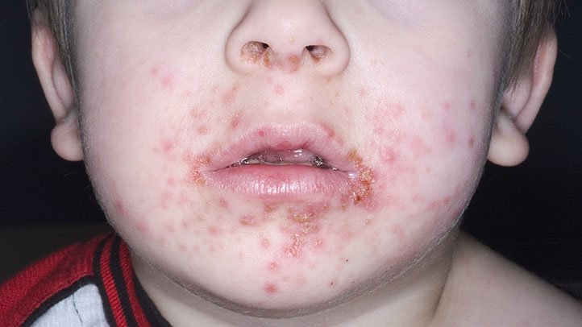
Impetigo is usually more wide spread, does not start with blisters and has a honey-coloured crust. Impetigo tends to spread out to form further patches and does not necessarily start close to the lips. It is less common than cold sores and tends to affect children.

Slide 6
Practical point
preventing cross–infection:
1-Patient should be aware that HSV1 is contagious and transmitted by direct contact especially in first 1-4 days (avoid kissing and don’t share towel and wash their hands after applying products).
2-For those patients in whom the sun triggers cold sores advice to use a sun block.

Slide 7
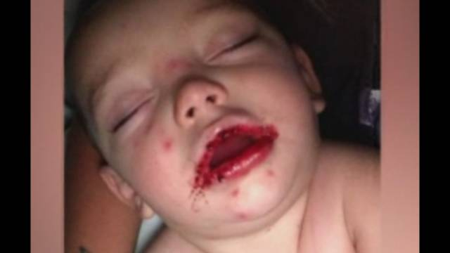

Slide 8
Management
1-Aciclovir (5% cream)(zovirax®):
The cream is applied five times daily, at 4-hourly intervals, starting, if possible, as soon as prodromal symptoms and continue for 5 days, can used for more 5 days if symptoms not resolved.
2-Penciclovir For people over 12 years of age it should be applied every 2 hours during waking period (about 8 times) and treatment continued for 4 days.

Slide 9
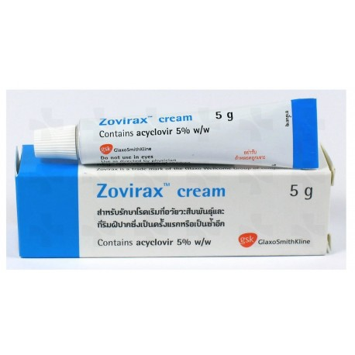

Slide 10
Bland creams Keeping the cold sore moist will prevent drying and cracking, which might predispose to secondary bacterial infection.
For the patient who suffers only an occasional cold sore, a simple cream, perhaps containing an antiseptic agent can help to reduce discomfort (Celavex®)cetrimide

